Slide 1
Question Answering
Using Knowledge in QA

Slide 2
Relation Extraction
Answers: Databases of Relations
born-in(“Emma Goldman”, “June 27 1869”)
author-of(“Cao Xue Qin”, “Dream of the Red Chamber”)
Draw from Wikipedia infoboxes, DBpedia, FreeBase, etc.
Questions: Extracting Relations in Questions
Whose granddaughter starred in E.T.?
(acted-in ?x “E.T.”)
(granddaughter-of ?x ?y)

Slide 3
Temporal Reasoning
Relation databases
(and obituaries, biographical dictionaries, etc.)
IBM Watson
”In 1594 he took a job as a tax collector in Andalusia”
Candidates:
Thoreau is a bad answer (born in 1817)
Cervantes is possible (was alive in 1594)

Slide 4
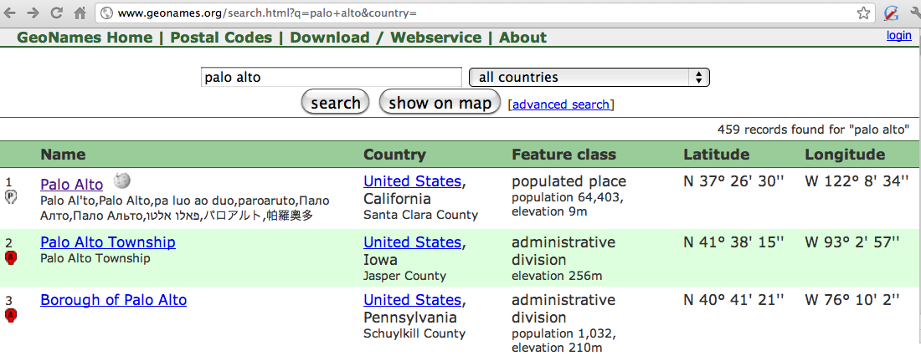
Geospatial knowledge (containment, directionality, borders)
Beijing is a good answer for ”Asian city”
California is ”southwest of Montana”
geonames.org:

Slide 5
Context and Conversation in Virtual Assistants like Siri
Coreference helps resolve ambiguities
U: “Book a table at Il Fornaio at 7:00 with my mom”
U: “Also send her an email reminder”
Clarification questions:
U: “Chicago pizza”
S: “Did you mean pizza restaurants in Chicago or Chicago-style pizza?”

Slide 6
Question Answering
Using Knowledge in QA

